Slide 1
Organizational Health
Framework for Fiscal Sponsors
This work is licensed under a Creative Commons Attribution-NonCommercial-ShareAlike 4.0 International Public License
This means you can adapt this work and share its contents freely for non-commercial purposes, provided you credit Social Impact Commons.

Slide 2
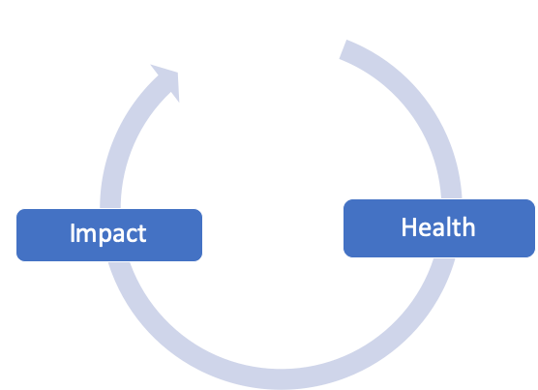
Health vs. Impact
Organizational health and impact are two sides of the same coin. They should reinforce each other in a virtuous cycle.
Health answers a range of questions related to, “How much are we doing, and how well are we operating?”
Impact answers a range of questions relate to, “How well are we supporting the capacity of our projects?”

Slide 3
Health Assessment Assumptions
There are many organizational health frameworks and motivations in the nonprofit sector: benchmarking, case making, strategic planning, governance oversight.
Our proposed Health Assessment is focused on the following values/assumptions:
Fiscal sponsorship resists “standardization”, beyond the most basic legal, financial, and compliance practices and principles.
The goal of assessment therefore is awareness and intentionality of practice and cultivating a whole systems view of our work.
Some key dimensions of assessment require a 360-degree manner: self and stakeholders.

Slide 4
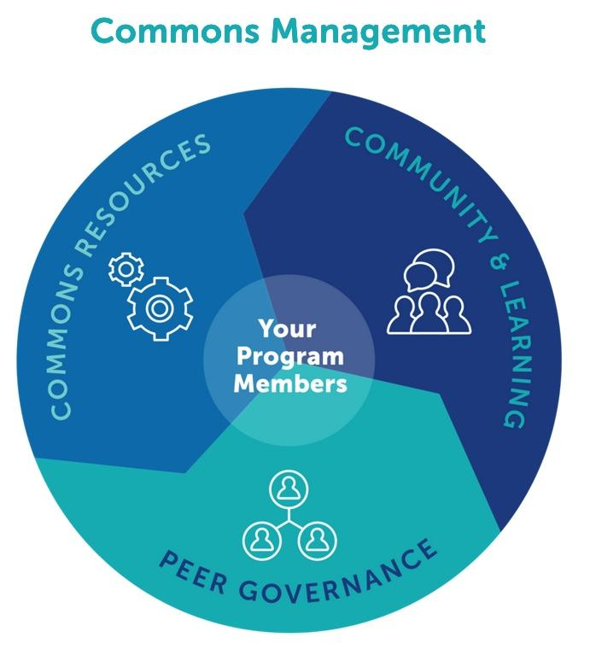
Commoning as a Framework
Commoning Practice
In the interest of centering equity, diversity, and inclusion in our work...
Our approach to fiscal sponsorship practices is infused with principles of commoning, or commons management.
The field of commoning practice has a long history and is enjoying renewed interest, as it concerns more equitable and participatory management principles focused on mutual care and economic self-sufficiency.
Our model of commoning, applied to the fiscal sponsorship field, is lightly adapted from the work of Silke Helfrich and David Bollier and their notion of the “commoning triad”.

Slide 5
Health Framework Dimensions
SHARED RESOURCES
Program
People
Finance
Systems
SHARED POWER
Governance
Decision Making
Transparency
Trust
SHARED COMMUNITY
Facilitated Learning
Anti-Oppression
Relationship Building
Field Participation
SHARED RESOURCES
SHARED POWER
SHARED COMMUNITY

Slide 6
Levels of Assessment
We’re thinking of the assessment process in three optional levels of intensity, each applied to all three dimensions:
BASIC
– Foundational objective (quantitative) data points.
– All questions are answered.
IN-DEPTH
– Detailed objective operational data points (operational assessment).
– All or a subset of categories can be selected to customize the profile.
– Questions remain objective in nature, but delve into greater detail.
360 DEGREE
– Multi-stakeholder input focused on qualitative data points.
– The in-depth profile is followed, focusing on qualitative 360 inputs.
Objective Data
Increasing Level of Effort
Subjective Data

Slide 7
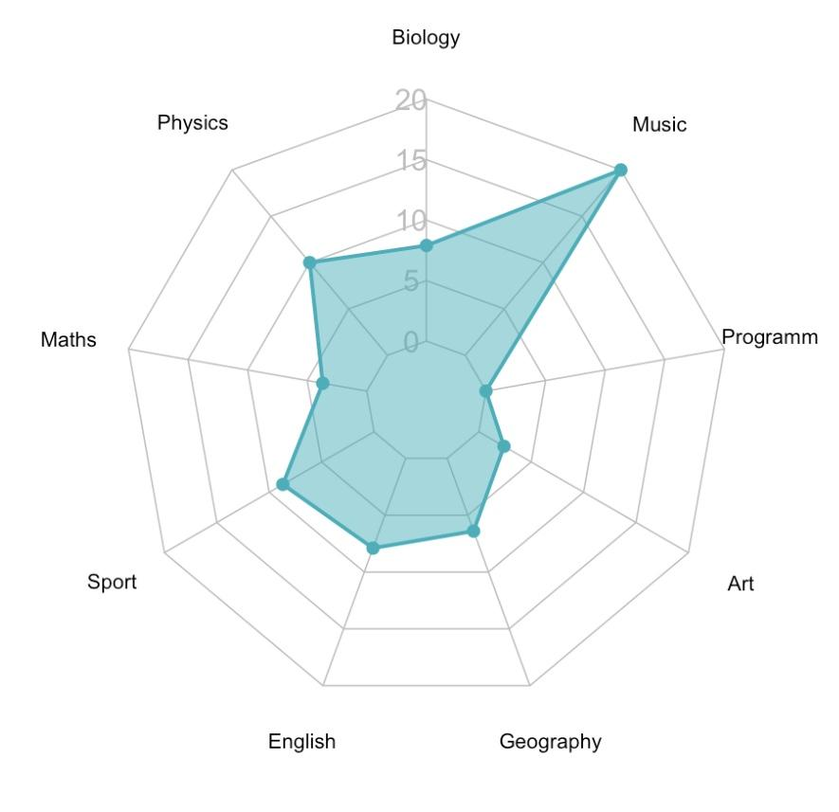
Assessment Output
Spider Graph Analysis
Allows for each organization to have its own “footprint”.
Can show change over time in different dimensions.
Can show progress overtime in overall surface area.

Slide 8
Thaddeus Squire, Chief Commons Steward thaddeus@socialimpactcommons.org
215 760 1634
Asta Petkeviciute, Chief Financial Steward
asta@socialimpactcommons.org
617 448 9559
http://socialimpactcommons.org
Generous support for the development and work of Social Impact Commons has been provided by:

Slide 9
Sample Basic Assessment: Resources Dimension
Program
Do you have written project criteria and intake/onboarding processes
Do you have written descriptions of the services/resources you offer? Y/N
Do you have Fiscal Sponsorship Agreement(s) and policies/guidelines for projects? Y/N
Do you negotiate costs for services individually with each project? Y/N/S
Do you have a published pricing structure that applies to all projects? Y/N
Do you have a documented portfolio/community development strategy/plan? Y/N
People
What is your estimated number of FTEs per sponsored project? [calculation method]
What is the demography of your core staff and/or principle contractors? [Candid protocol]
What is the demography of your board and advisors (if applicable) [Candid protocol]
Do you have pay scale policies that incorporate equity/justice considerations? Y/N
Do you offer healthcare or retirement benefits to your core and project staff? Y/N
Do you offer other benefits/support to your staff (i.e., PD, childcare, disability, etc.)? Y/N
Finance
Did you end your most recent fiscal year with positive Liquid Unrestricted Net Assets? Y/N
Are you current on all federal, state, and local tax and regulatory filings? Y/N
Do you know the cost-to-operate your fiscal sponsorship program minus the activity of your projects (“core operations”)? Y/N
How many months of cash on hand do you have to cover your core operations? NN/CA
Do you have written policies and practices for project spend/encumbrance management? Y/N
Do you maintain fund-based and/or multi-entity, accrual-based accounting? Y/N
Systems
Do you have a financial management tool for analyzing and monitoring your portfolio? Y/N
Do you have a comprehensive employee manual/handbook? Y/N
Do you have an accounting system set up for fund-based and/or multi-entity accounting? Y/N
Do you have a Constituent Relationship Management (CRM) system? Y/N N/A
Do you have a Human Resource Management system or outsource HR management? Y/N
Do you have document and data management systems and policies? Y/N

